Slide 1
Weekly Report
skyforce / RSEE4
2010/09/30

Slide 2
CCTv3 Improvement Research - Status
Progress
AUO 11307 Platform
Problem
UI移植
Future Plan
AUO 11307 Platform
Auto Adjust Color Database
Dim Grey Fix: Find Reasonable Target White

Slide 3
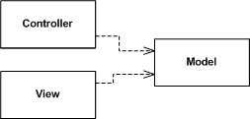
GUI Architectures
Forms and Controls
It doesn't have a common name. It's a familiar architecture because it was the one encouraged by client-server development environments in the 90's - tools like Visual Basic, Delphi, and Powerbuilder.
The form observes the controls and has handler methods to react to interesting events raised by the controls.
Model View Controller
Make a strong separation between presentation (view & controller) and domain (model)
Divide GUI widgets into a controller (for reacting to user stimulus) and view (for displaying the state of the model). Controller and view should (mostly) not communicate directly but through the model.
Have views (and controllers) observe the model to allow multiple widgets to update without needed to communicate directly .

Slide 4
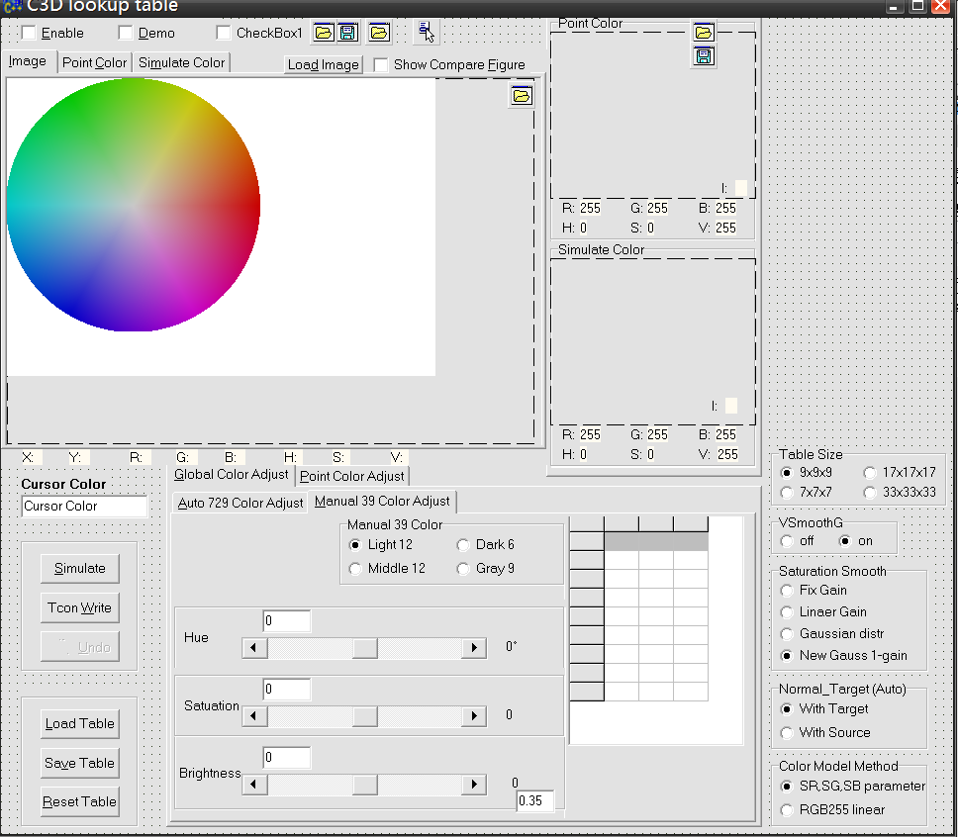
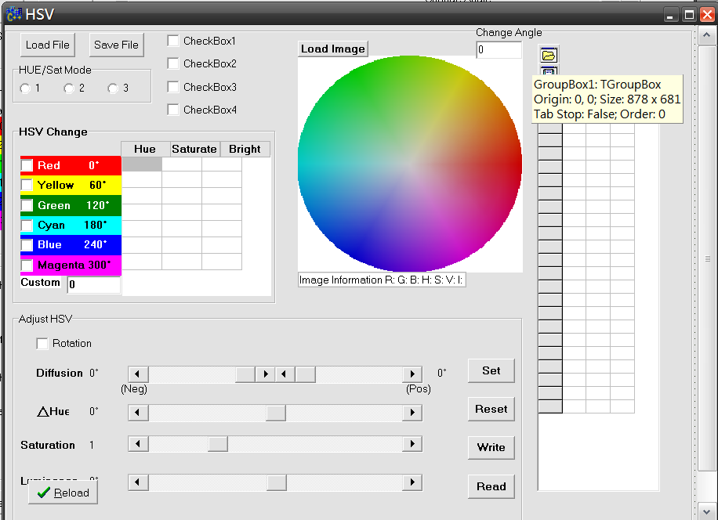
UI移植
Purpose
Hue中缺乏的色塊顯示功能
將C3D中的UI移植到Hue使用, 包括
Color Picker
色彩選擇
色彩轉換模擬
色塊顯示
Color Adjust
HSV調整
使用TFrame做UI移植
節省系統資源, 避免重複設計相同UI
建立可重複使用的物件，就如同視覺化繼承一個 TForm 一樣。
使C3D與HUE透過TFrame可共用UI。
Color Picker
Replace
Color Adjust
Replace

Slide 5
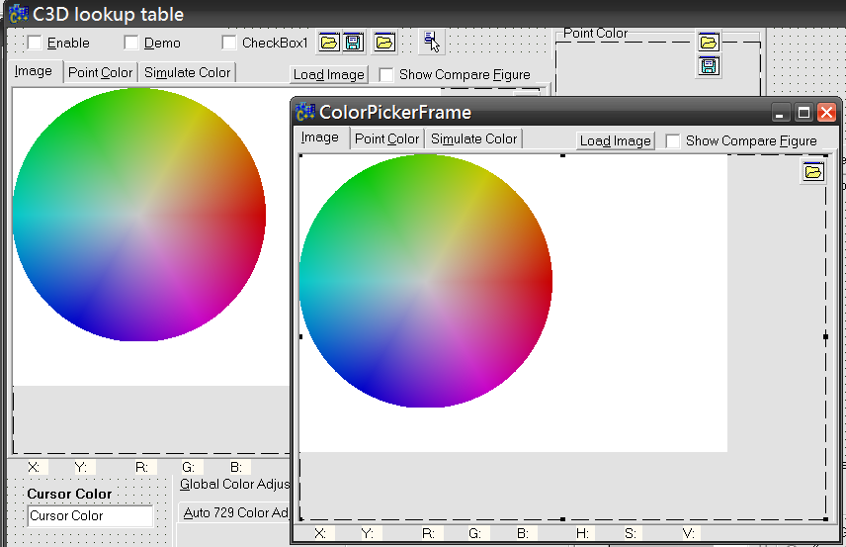
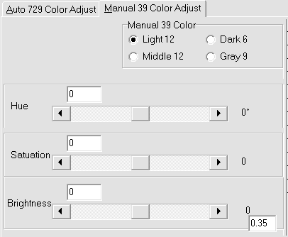
UI移植
UI的移植過程
將TForm內的部分元件組合獨立成為TFrame
將TForm的事件處理中:
與TFrame內相關的UI事件保留在TFrame內
與TFrame內無關的UI事件改以事件監聽(Listener)處理, 降低UI間的耦合性
將原本Forms and Controls分離成為Model View Controller模式(因耦合性高, 部份元件無法達成), 降低UI與Logic間的耦合性
TForm
TFrame
Handler
Listener
alter
listen() {....}
alter
register
func() {....}
handle
fire

Slide 6
 |  |  |  | 2010 Aug |  |  |  | 2010 Sep |  |  |  | 2010 Oct
List | Item | Start | End | 8/2 | 8/9 | 8/16 | 8/23 | 9/6 | 9/13 | 9/20 | 9/27 | 10/4 | 10/11 | 10/18 | 10/25
CCTv3 | 下視角亮度差
 | Dim Grey Fix | 10/9 | 11/8
 | -可調整Dim Target White功能實作
 | -低灰階異色threshold實驗
 | -最適Dim Target White自動產生
 | Non-stable CCT (B116XW03)
 | -面板特性解析
 | Workbook | 11/9 | 11/12
PD Issue | Non-stable CCT (12306)
 | -特性解析
AUO-11307 Platform | HSV manual-adjustment revised | 8/25 | 9/13
 | color engine toolkit integrated | 9/14 | 9/17
 | Sharpness/CM/HSV/CCT verification | 9/14 | 9/17
Color Database | color engine auto-toolkit | 9/20 | 10/8
 | -gamut mapping | 9/20 | 9/21
 | -embedded in CM/HSV auto-toolkit | 9/20 | 10/8
 | color database | 9/20 | 10/8
 | color engine SOP | 10/8 | 10/8

